Slide 1




LANGSCAPE: LANGUAGE LEARNING APPLICATION

Slide 2
DEVELOPMENT
Developed using React JS and MongoDB
Features: Authentication, Language Selection, Dashboard with Progress Tracking

Slide 3
PROJECT OVERVIEW
LangScape is a web-based app designed for language learners.
Offers three languages: Kannada, English, and others.
Allows users to track their learning progress.

Slide 4
KEY FEATURES
User Authentication: Secure login and sign-up.
Language Selection: Choose a language from the available options.
Dashboard: Displays language details.
Progress Bar: Shows learning progress dynamically.

Slide 5
TECHNOLOGY STACK
Frontend: React JS
Backend: MongoDB
Authentication: Firebase
Styling: CSS3

Slide 6
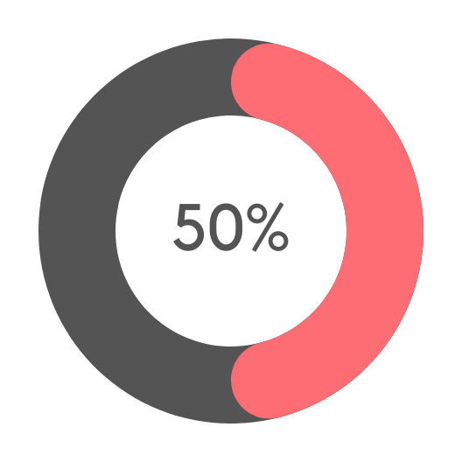
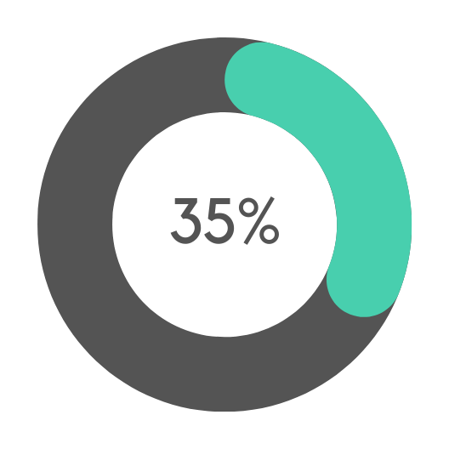
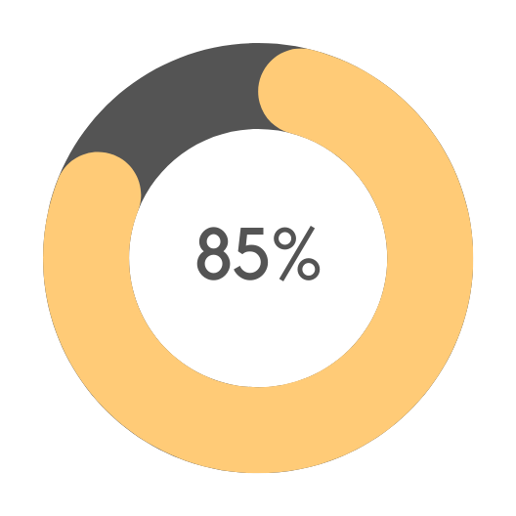
APPLICATION STRUCTURE
AUTHENTICATION PAGE: SECURE USER LOGIN.
LANGUAGE SELECTION: CHOOSE LANGUAGE FROM KANNADA, ENGLISH, ETC.
DASHBOARD: DISPLAYS LANGUAGE INFO AND TRACKS LEARNING.

Slide 7
DATABASE STRUCTURE
USERS: STORES USER DATA AND PROGRESS.
LANGUAGES: STORES DETAILS ABOUT AVAILABLE LANGUAGES.
LESSONS: STORES INDIVIDUAL LESSONS FOR EACH LANGUAGE.

Slide 8
TECHNOLOGY STACK
POST: /AUTH/REGISTER, /AUTH/LOGIN
01 - BRANDINGGET: /LANGUAGES, /DASHBOARD/:LANGUAGEID
POST: /PROGRESS/UPDATE

Slide 9
PROGRESS TRACKING
The progress bar updates based on lessons completed.
Shows the percentage of language learned.

Slide 10
FUTURE ENHANCEMENTS
Add more languages.
Gamification (achievements, rewards).
Mobile app development.
Personalized learning paths.

Slide 11
CONCLUSION
LangScape is a scalable, interactive app for language learning.
Built with modern technologies for easy expansion.

